Slide 1


Indexing with
The JSON T-SQL Operators
• FOR JSON AUTO
• FOR JSON PATH
• ISJSON()
• JSON_ARRAY()
• JSON_MODIFY()
• JSON_OBJECT()
• JSON_PATH_EXISTS()
• JSON_QUERY()
• JSON_VALUE()
• OPENJSON()

Slide 2
Indexing JSON

Slide 3
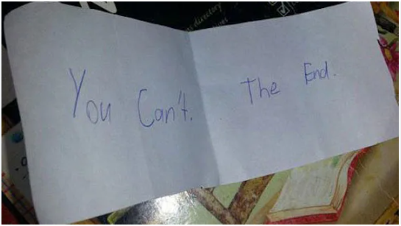

Slide 4
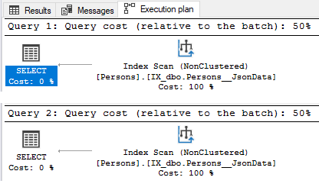
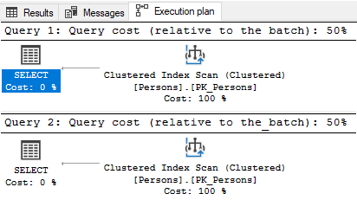
SELECT *
FROM dbo.Persons
WHERE JsonData LIKE '%"name":"Jeff Foushee"%'
SELECT *
FROM dbo.Persons
WHERE JSON_VALUE(JsonData, '$.name') = 'Jeff Foushee'
(With explicit index on JsonData column)
(Without nonclustered index on JsonData column)
Notes:
Putting an index on the JSON column did nothing for us. Notice that with/without the index, neither query had an advantage.

Slide 5
“Indexing” JSON
Using computed columns to simulate how users will “JSON_QUERY” the data. Index the computed columns.
Using computed columns to build a value that wasn’t otherwise available in the original JSON. Index the computed columns.
Using table-triggers to deconstruct JSON into child tables. Index the joining columns.

Slide 6

“Indexing” JSON (1 object, 1 value)
INSERT INTO dbo.Persons (JsonData)
VALUES('{
"name":"Jeff Foushee"
, "parents":[{"name":"Mom"},{"name":"Dad"}]
, "json_expert":false
}')

Slide 7
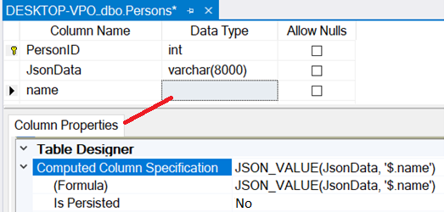
“Indexing” JSON (1 object, 1 value)
JSON_VALUE([JsonData],'$.name')
PERSISTED = False
SELECT TOP (1000) [PersonID]
,[JsonData]
,[name]
FROM [JsonDemo].[dbo].[Persons]

Slide 8
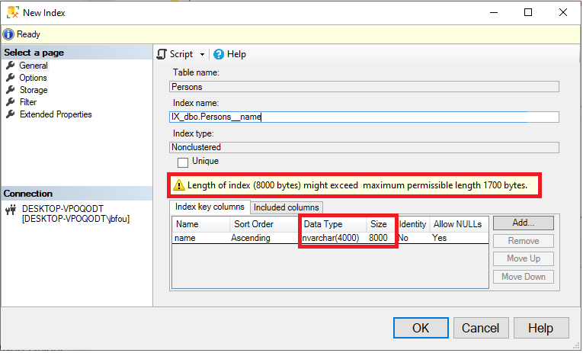

Slide 9
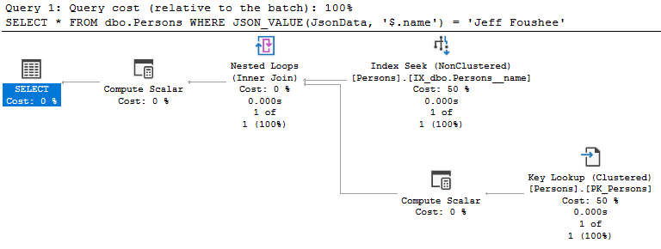
Now it’s a Seek
Verbatim to the definition of an indexed column
SELECT *
FROM dbo.Persons
WHERE JSON_VALUE(JsonData, '$.name') = 'Jeff Foushee'

Slide 10
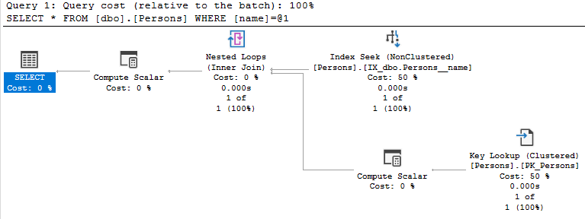
Now it’s a Seek
The name of the computed column that is indexed
SELECT *
FROM dbo.Persons
WHERE [name] = 'Jeff Foushee'

Slide 11
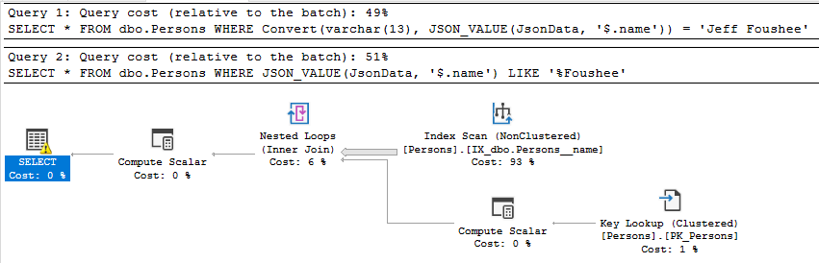
Not verbatim to the definition of an indexed column
SELECT *
FROM dbo.Persons
WHERE Convert(varchar(13), JSON_VALUE(JsonData, '$.name')) = 'Jeff Foushee'
SELECT *
FROM dbo.Persons
WHERE JSON_VALUE(JsonData, '$.name') LIKE '%Foushee'
Not an equality condition

Slide 12
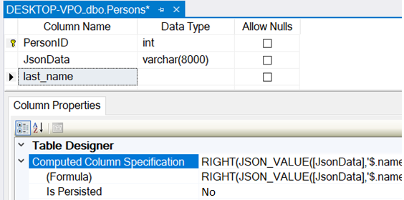

“Indexing” JSON (1 object, 1 value)
RIGHT(
JSON_VALUE([JsonData],'$.name')
, LEN(JSON_VALUE([JsonData],'$.name'))
- CHARINDEX(' ',JSON_VALUE([JsonData],'$.name'))
)
SELECT TOP (1000) [PersonID]
,[JsonData]
,[last_name]
FROM [JsonDemo].[dbo].[Persons]

Slide 13
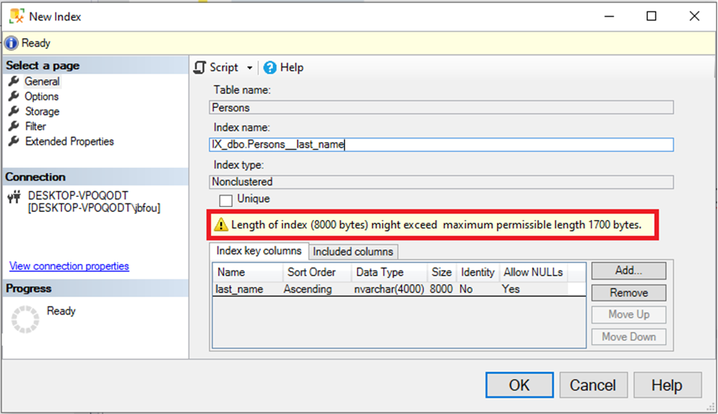

Slide 14

“Indexing” JSON (1 object, 1 value)
Convert(varchar(128),
RIGHT(JSON_VALUE([JsonData],'$.name')
, LEN(JSON_VALUE([JsonData],'$.name'))
- CHARINDEX(' ',JSON_VALUE([JsonData],'$.name'))
)
)
)
PERSISTED = True
SELECT TOP (1000) [PersonID]
,[JsonData]
,[last_name]
FROM [JsonDemo].[dbo].[Persons]
Notes:
I can shrink the column length down for two reasons:
1. No one is going to take advantage of the index by verbatim syntax at this point anyway
2. No one should have a last name larger than 128 characters
I’m also going to favor disk over CPU by storing the value via the PERSISTED keyword

Slide 15
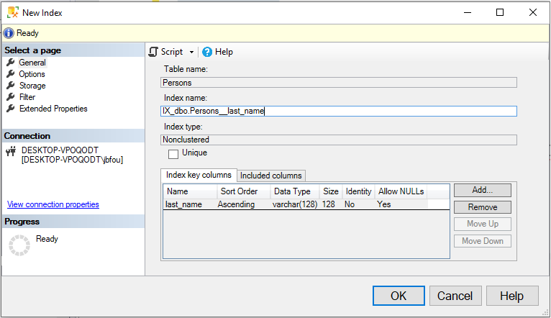

Slide 16
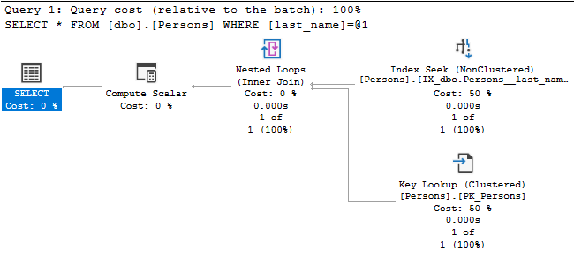
Now it’s a Seek
The name of the computed column that is indexed
SELECT *
FROM dbo.Persons
WHERE last_name = 'Foushee'

Slide 17
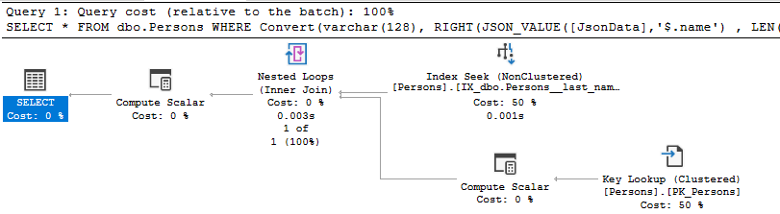
Now it’s a Seek
Verbatim to the definition of an indexed column
SELECT *
FROM dbo.Persons
WHERE Convert(varchar(128),
RIGHT(JSON_VALUE([JsonData],'$.name')
, LEN(JSON_VALUE([JsonData],'$.name'))
- CHARINDEX(' ',JSON_VALUE([JsonData],'$.name')) ) )
= 'Foushee'
Notes:
I can get an index seek if I duplicate the definition of the computed column, but I cannot expect developers to use this syntax verbatim.

Slide 18
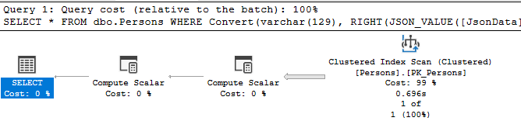
Not verbatim to the definition of an indexed column
SELECT *
FROM dbo.Persons
WHERE Convert(varchar(129),
RIGHT(JSON_VALUE([JsonData],'$.name')
, LEN(JSON_VALUE([JsonData],'$.name'))
- CHARINDEX(' ',JSON_VALUE([JsonData],'$.name')) ) )
= 'Foushee'
Notes:
And anything beyond the verbatim definition will result in an index scan.

Slide 19
Demo Time

Slide 20
“Indexing” JSON (1 object, multi-value)
INSERT INTO dbo.Persons (JsonData)
VALUES('{
"name":"Jeff Foushee"
, "parents":[{"name":"Mom"},{"name":"Dad"}]
, "json_expert":false
}')

Slide 21
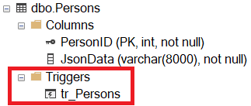
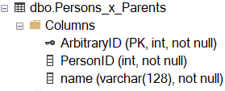
CREATE TRIGGER dbo.tr_Persons ON dbo.Persons
FOR INSERT, DELETE, UPDATE
AS
BEGIN
SET NOCOUNT ON;
IF EXISTS (SELECT 1 FROM deleted)
BEGIN
DELETE affected
FROM [dbo].[Persons_x_Parents] affected
INNER JOIN deleted
ON deleted.PersonID = affected.PersonID
END
--ENDIF
IF EXISTS (SELECT 1 FROM inserted)
BEGIN
INSERT INTO [dbo].[Persons_x_Parents]
(PersonID, [name])
SELECT i.PersonID, JSON_VALUE(p.[value], '$.name')
FROM inserted i
CROSS APPLY OPENJSON(i.JsonData, '$.parents') p
END
--ENDIF
END
GO
“Magic tables”
Notes:
Since Parents are a one-to-many relationship, I will build a one-to-many relationship table.
I will then build a trigger to monitor the incoming JSON and rebuild this Persons_x_Parents table data for the affected rows.

Slide 22

INSERT INTO dbo.Persons (JsonData)
VALUES('{
"name":"Jeff Foushee"
, "parents":[{"name":"Mom"},{"name":"Dad"}]
, "json_expert":false
}')
dbo.Persons
dbo.Persons_x_Parents
Notes:
When I add data to the dbo.Persons table, the JSON is parsed and sent to the dbo.Persons_x_Parents table

Slide 23
UPDATE dbo.Persons
SET JsonData = '{
"name":"Jeff Foushee"
, "parents":[{"name":"Mom"},{"name":"Dad"}]
, "json_expert":true
}'
WHERE ...
UPDATE [dbo].[Persons]
SET JsonData = JSON_MODIFY(JsonData, '$.json_expert', 'true')
WHERE ...
dbo.Persons
dbo.Persons_x_Parents
-> 3
-> 4
Notes:
When I update a JSON property, notice the rows in dbo.Persons_x_Parents were re-written. Why?

Slide 24
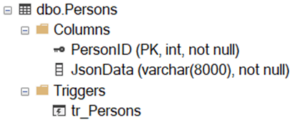
CREATE TRIGGER dbo.tr_Persons ON dbo.Persons
FOR INSERT, DELETE, UPDATE
AS
BEGIN
SET NOCOUNT ON;
IF EXISTS (SELECT 1 FROM deleted)
BEGIN
DELETE affected
FROM [dbo].[Persons_x_Parents] affected
INNER JOIN deleted
ON deleted.PersonID = affected.PersonID
END
--ENDIF
IF EXISTS (SELECT 1 FROM inserted)
BEGIN
INSERT INTO [dbo].[Persons_x_Parents]
(PersonID, [name])
SELECT i.PersonID, JSON_VALUE(p.[value], '$.name')
FROM inserted i
CROSS APPLY OPENJSON(i.JsonData, '$.parents') p
END
--ENDIF
END
GO
Notes:
The trigger was written that way. An update is a combination of rows in inserted and deleted.

Slide 25
ALTER TRIGGER [dbo].[tr_Persons] ON [dbo].[Persons]
FOR INSERT, DELETE, UPDATE
AS
BEGIN
SET NOCOUNT ON;
DECLARE @_ModType char(1)
IF EXISTS (SELECT 1 FROM inserted)
BEGIN
IF EXISTS (SELECT 1 FROM deleted)
SET @_ModType = 'U'
ELSE
SET @_ModType = 'I'
END
ELSE
SET @_ModType = 'D'
DECLARE @_PersonID int
SELECT @_PersonID = ISNULL(i.PersonID, d.PersonID) FROM inserted i, deleted d
IF @_ModType IN ('U', 'I')
BEGIN
SELECT i.PersonID, JSON_VALUE(p.[value], '$.name') AS '$.name'
INTO #temp
FROM inserted i
CROSS APPLY OPENJSON(i.JsonData, '$.parents') p
MERGE [dbo].[Persons_x_Parents] AS [target]
USING #temp AS [source]
ON [source].PersonID = [target].PersonID
AND [source].[$.name] = [target].[name]
WHEN NOT MATCHED BY TARGET THEN
INSERT (PersonID, [name])
VALUES ([source].PersonID, [source].[$.name])
WHEN NOT MATCHED BY SOURCE
AND [target].PersonID = @_PersonID
THEN DELETE;
END
IF @_ModType = 'D'
DELETE affected
FROM [dbo].[Persons_x_Parents] affected
INNER JOIN deleted
ON deleted.PersonID = affected.PersonID
END
Notes:
Let’s fix the trigger to account for inserts, updates, and deletes. We can detect the modification type based on data (or lack of data) in the tables inserted and deleted

Slide 26
ALTER TRIGGER [dbo].[tr_Persons] ON [dbo].[Persons]
FOR INSERT, DELETE, UPDATE
AS
BEGIN
SET NOCOUNT ON;
DECLARE @_ModType char(1)
IF EXISTS (SELECT 1 FROM inserted)
BEGIN
IF EXISTS (SELECT 1 FROM deleted)
SET @_ModType = 'U'
ELSE
SET @_ModType = 'I'
END
ELSE
SET @_ModType = 'D'
DECLARE @_PersonID int
SELECT @_PersonID = ISNULL(i.PersonID, d.PersonID) FROM inserted i, deleted d
IF @_ModType IN ('U', 'I')
BEGIN
SELECT i.PersonID, JSON_VALUE(p.[value], '$.name') AS '$.name'
INTO #temp
FROM inserted i
CROSS APPLY OPENJSON(i.JsonData, '$.parents') p
MERGE [dbo].[Persons_x_Parents] AS [target]
USING #temp AS [source]
ON [source].PersonID = [target].PersonID
AND [source].[$.name] = [target].[name]
WHEN NOT MATCHED BY TARGET THEN
INSERT (PersonID, [name])
VALUES ([source].PersonID, [source].[$.name])
WHEN NOT MATCHED BY SOURCE
AND [target].PersonID = @_PersonID
THEN DELETE;
END
IF @_ModType = 'D'
DELETE affected
FROM [dbo].[Persons_x_Parents] affected
INNER JOIN deleted
ON deleted.PersonID = affected.PersonID
END
Notes:
By segmenting ModTypes, I can prevent data from being simultaneously inserted and deleted.

Slide 27
ALTER TRIGGER [dbo].[tr_Persons] ON [dbo].[Persons]
FOR INSERT, DELETE, UPDATE
AS
BEGIN
SET NOCOUNT ON;
DECLARE @_ModType char(1)
IF EXISTS (SELECT 1 FROM inserted)
BEGIN
IF EXISTS (SELECT 1 FROM deleted)
SET @_ModType = 'U'
ELSE
SET @_ModType = 'I'
END
ELSE
SET @_ModType = 'D'
DECLARE @_PersonID int
SELECT @_PersonID = ISNULL(i.PersonID, d.PersonID) FROM inserted i, deleted d
IF @_ModType IN ('U', 'I')
BEGIN
SELECT i.PersonID, JSON_VALUE(p.[value], '$.name') AS '$.name'
INTO #temp
FROM inserted i
CROSS APPLY OPENJSON(i.JsonData, '$.parents') p
MERGE [dbo].[Persons_x_Parents] AS [target]
USING #temp AS [source]
ON [source].PersonID = [target].PersonID
AND [source].[$.name] = [target].[name]
WHEN NOT MATCHED BY TARGET THEN
INSERT (PersonID, [name])
VALUES ([source].PersonID, [source].[$.name])
WHEN NOT MATCHED BY SOURCE
AND [target].PersonID = @_PersonID
THEN DELETE;
END
IF @_ModType = 'D'
DELETE affected
FROM [dbo].[Persons_x_Parents] affected
INNER JOIN deleted
ON deleted.PersonID = affected.PersonID
END
Notes:
I’ll use a TSQL MERGE statement to prevent both an INSERT and UPDATE from simultaneously happening.

Slide 28
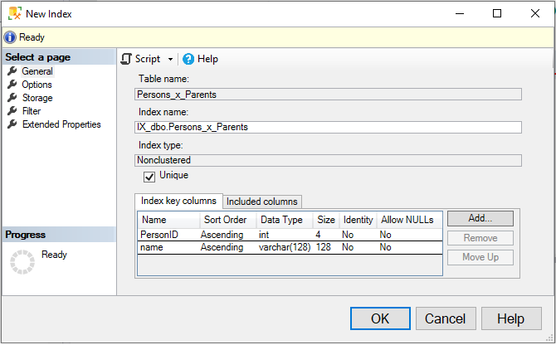
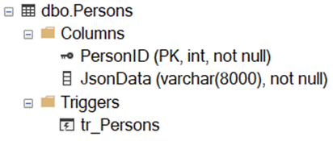

SELECT p.*
FROM dbo.Persons p
INNER JOIN dbo.Persons_x_Parents pxp
ON p.PersonID = pxp.PersonID
WHERE pxp.name = 'Mom'

Slide 29
Demo Time

Slide 30

“Indexing” JSON (multi-object, 1 value)
INSERT INTO dbo.Classes (JsonData)
VALUES('[
{
"name":"Jeff Foushee"
, "parents":[{"name":"Mom"},{"name":"Dad"}]
, "json_expert":false
}
,{
"name":"Jesús Castillo"
, "parents":[{"name":"Mary"},{"name":"Joseph"}]
, "json_expert":true
} ]')

Slide 31
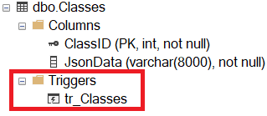
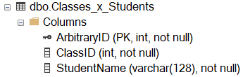
CREATE TRIGGER [dbo].[tr_Classes] ON [dbo].[Classes]
FOR INSERT, DELETE, UPDATE
AS
BEGIN
SET NOCOUNT ON;
DECLARE @_ModType char(1)
IF EXISTS (SELECT 1 FROM inserted)
BEGIN
IF EXISTS (SELECT 1 FROM deleted)
SET @_ModType = 'U'
ELSE
SET @_ModType = 'I'
END
ELSE
SET @_ModType = 'D'
DECLARE @_ClassID int
SELECT @_ClassID = ISNULL(i.ClassID, d.ClassID) FROM inserted i, deleted d
IF @_ModType IN ('U', 'I')
BEGIN
SELECT i.ClassID, JSON_VALUE(p.[value], '$.name') AS '$.name'
INTO #temp
FROM inserted i
CROSS APPLY OPENJSON(i.JsonData, '$') p
MERGE [dbo].[Classes_x_Students] AS [target]
USING #temp AS [source]
ON [source].ClassID = [target].ClassID
AND [source].[$.name] = [target].[name]
WHEN NOT MATCHED BY TARGET THEN
INSERT (ClassID, StudentName)
VALUES ([source].ClassID, [source].[$.name])
WHEN NOT MATCHED BY SOURCE
AND [target].ClassID = @_ClassID
THEN DELETE;
END
IF @_ModType = 'D'
DELETE affected
FROM [dbo].[Classes_x_Students] affected
INNER JOIN deleted
ON deleted.ClassID = affected.ClassID
END

Slide 32
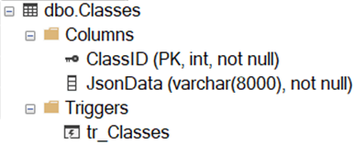
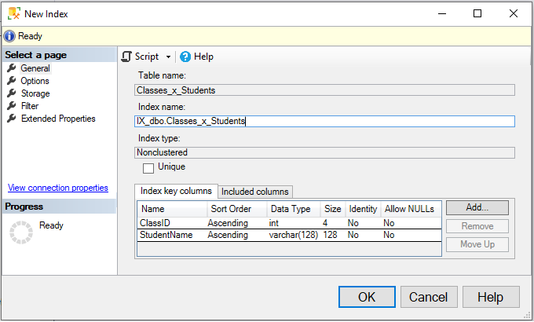
SELECT c.*
FROM dbo.Classes c
INNER JOIN dbo.Classes_x_Students cxs
ON c.ClassID = cxs.ClassID
WHERE cxs.StudentName = 'Jeff Foushee'

Slide 33
“Indexing” JSON (multi-object, multi-value)
INSERT INTO dbo.Classes (JsonData)
VALUES('[
{
"name":"Jeff Foushee"
, "parents":[{"name":"Mom"},{"name":"Dad"}]
, "json_expert":false
}
,{
"name":"Jesús Castillo"
, "parents":[{"name":"Mary"},{"name":"Joseph"}]
, "json_expert":true
} ]')

Slide 34
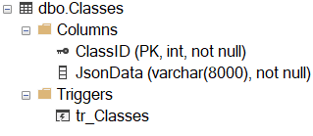
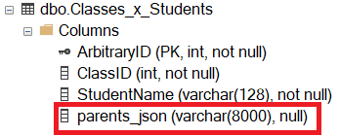
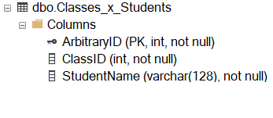
CREATE TRIGGER [dbo].[tr_Classes] ON [dbo].[Classes]
FOR INSERT, DELETE, UPDATE
AS
BEGIN
SET NOCOUNT ON;
DECLARE @_ModType char(1)
-- # Determine if (U)pdate, (I)nsert, or (D)elete
-- Skipped for brevity; see previous slides
DECLARE @_ClassID int
SELECT @_ClassID = ISNULL(i.ClassID, d.ClassID) FROM inserted i, deleted d
IF @_ModType IN ('U', 'I')
BEGIN
SELECT i.ClassID
, JSON_VALUE(p.[value], '$.name') AS '$.name'
, JSON_QUERY(p.[value], '$.parents') AS '$.parents'
INTO #temp
FROM inserted i
CROSS APPLY OPENJSON(i.JsonData, '$') p
MERGE [dbo].[Classes_x_Students] AS [target]
USING #temp AS [source]
ON [source].ClassID = [target].ClassID
AND [source].[$.name] = [target].[StudentName]
WHEN MATCHED THEN
UPDATE SET parents_json = [source].[$.parents]
WHEN NOT MATCHED BY TARGET THEN
INSERT (ClassID, [StudentName], parents_json)
VALUES ([source].ClassID, [source].[$.name], [source].[$.parents])
WHEN NOT MATCHED BY SOURCE
AND [target].ClassID = @_ClassID
THEN DELETE;
END
IF @_ModType = 'D'
DELETE affected
FROM [dbo].[Classes_x_Students] affected
INNER JOIN deleted
ON deleted.ClassID = affected.ClassID
END

Slide 35
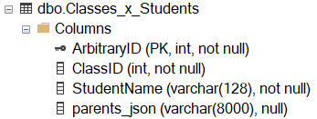

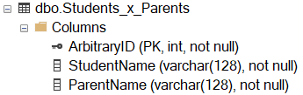
CREATE TRIGGER [dbo].[tr_Classes_x_Students] ON [dbo].[Classes_x_Students]
FOR INSERT, DELETE, UPDATE
AS
BEGIN
SET NOCOUNT ON;
DECLARE @_ModType char(1)
-- # Determine if (U)pdate, (I)nsert, or (D)elete
-- Skipped for brevity; see previous slides
DECLARE @_StudentName varchar(128)
SELECT @_StudentName = ISNULL(i.StudentName, d.StudentName)
FROM inserted i, deleted d
IF @_ModType IN ('U', 'I')
BEGIN
SELECT i.StudentName
, JSON_VALUE(p.[value], '$.name') AS '$.name'
INTO #temp
FROM inserted i
CROSS APPLY OPENJSON(i.parents_json, '$') p
MERGE [dbo].[Students_x_Parents] AS [target]
USING #temp AS [source]
ON [source].StudentName = [target].StudentName
AND [source].[$.name] = [target].ParentName
WHEN NOT MATCHED BY TARGET THEN
INSERT (StudentName, ParentName)
VALUES ([source].StudentName, [source].[$.name])
WHEN NOT MATCHED BY SOURCE
AND [target].StudentName = @_StudentName
THEN DELETE;
END
IF @_ModType = 'D'
DELETE affected
FROM [dbo].[Students_x_Parents] affected
INNER JOIN deleted
ON deleted.StudentName = affected.StudentName
END

Slide 36
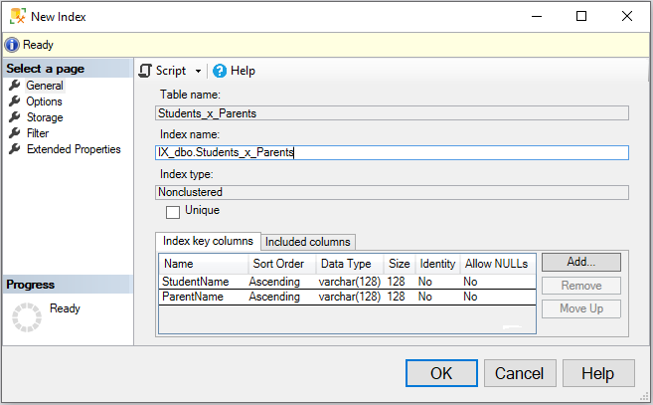
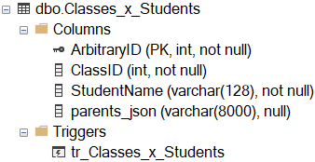
SELECT c.*
FROM dbo.Classes c
INNER JOIN dbo.Classes_x_Students cxs
ON c.ClassID = cxs.ClassID
INNER JOIN dbo.Students_x_Parents sxp
ON cxs.StudentName = sxp.StudentName
WHERE sxp.ParentName = 'Mom'

Slide 37
Demo Time

Slide 38
Advocating for normalizing all JSON data into RDMBS?

